Slide 1

A website for Project Management System
Abhinab Mishra
Soumya Srivastava
Melvin K Milkiyas

Slide 2
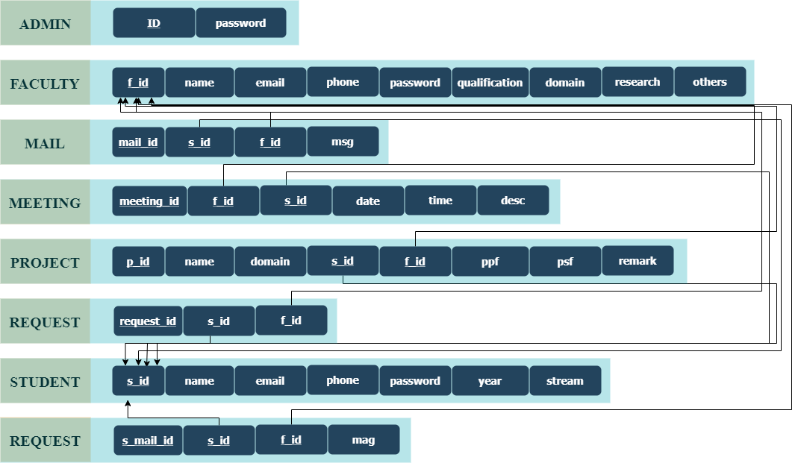
Schema Diagram :

Slide 3
The website unfolds by delivering a login page where the user logs in as one of the following categories with the ID and password:
Admin
Student
Faculty
The admin is authorized to provide the user with the ID and password

Slide 4
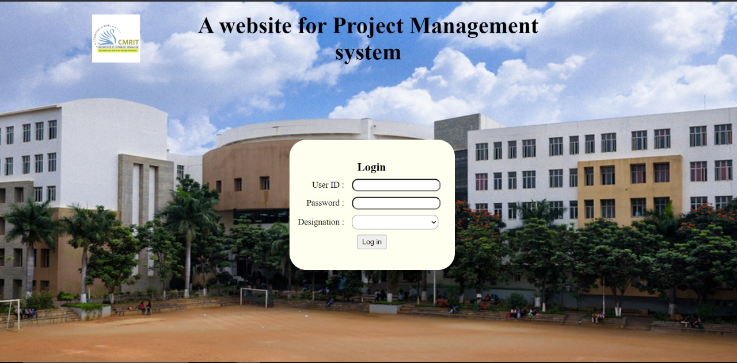
Login page:

Slide 5
Once the user logs in as admin he/she can perform the following:
Add Student: The details such as student id, name, email, phone number, password, year and stream are entered.
Add Faculty: The user enters the faculty id, name, email, phone, password and their qualification to add a faculty.
Search Student: A student can be searched by selecting their ID, once the search results are displayed the user can update it.
Search Faculty: A faculty can be searched by selecting their ID, once the search results are displayed the user can update it.
Allocate: The admin is able to check if a particular student is working on a project under a faculty and can allocate a project to them.
Reports: The existing project details and review meeting details are entered.
Logout: The admin can logout to allow another user to login.

Slide 6
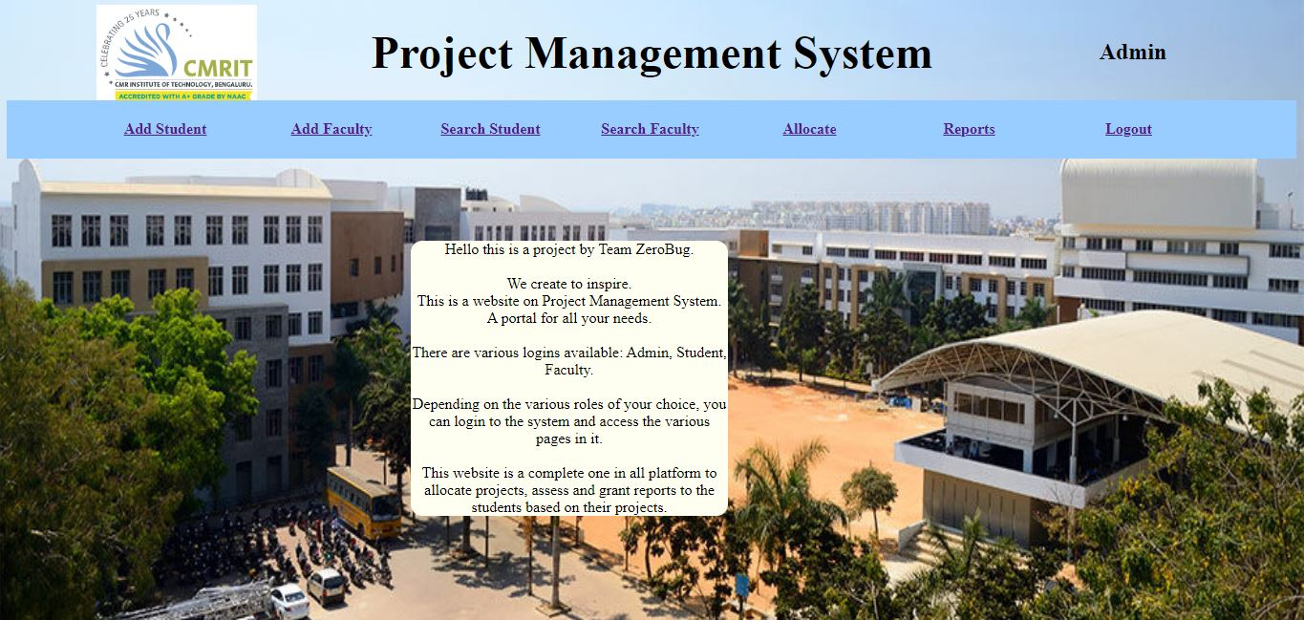
Admin Dashboard:

Slide 7
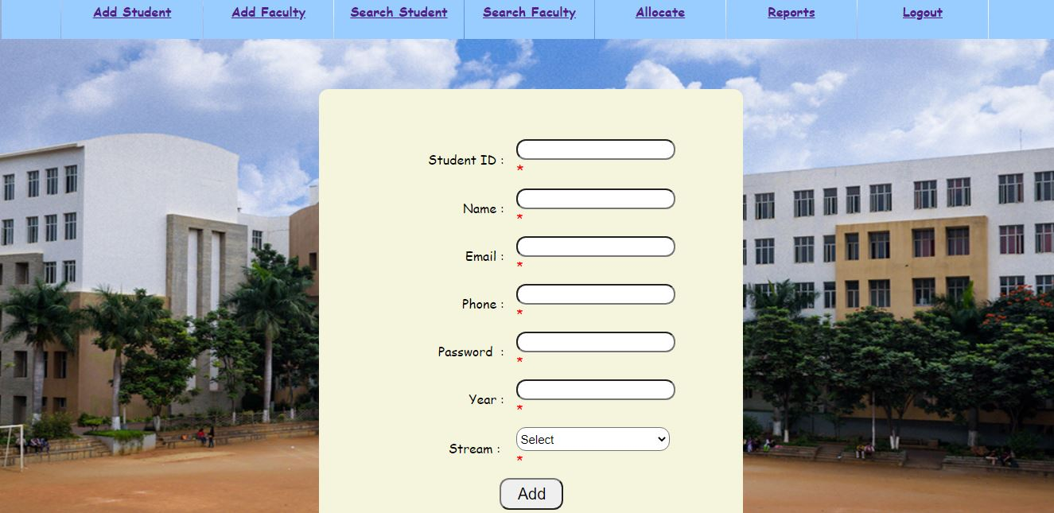
Add Student:

Slide 8
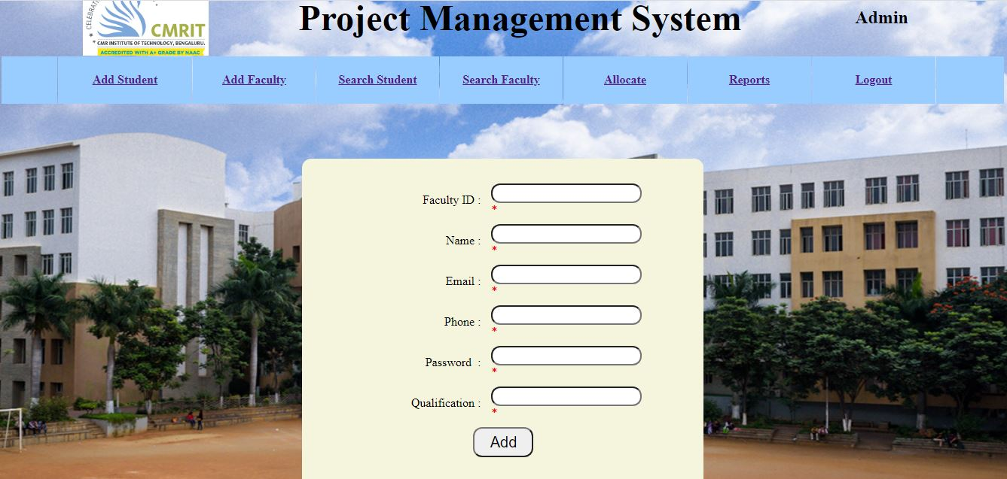
Add Faculty:

Slide 9
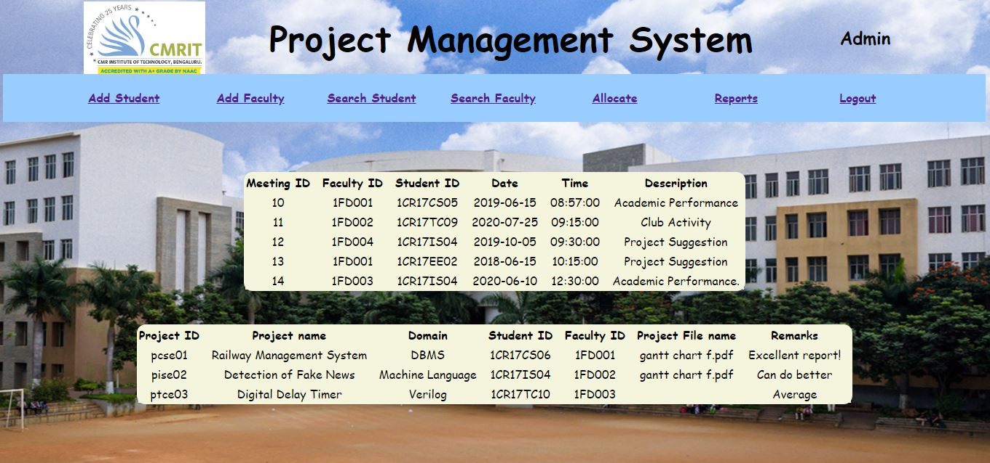
Reports:

Slide 10
A student user can perform the following:
Project: Allows the student to upload the Project Proposal or the Project Specification and request for the feedback
Interact: This section provides the students to send a message to a faculty, to check their inbox for any messages from the faculty and also to check all the messages sent by the student
Logout: The student may logout

Slide 11
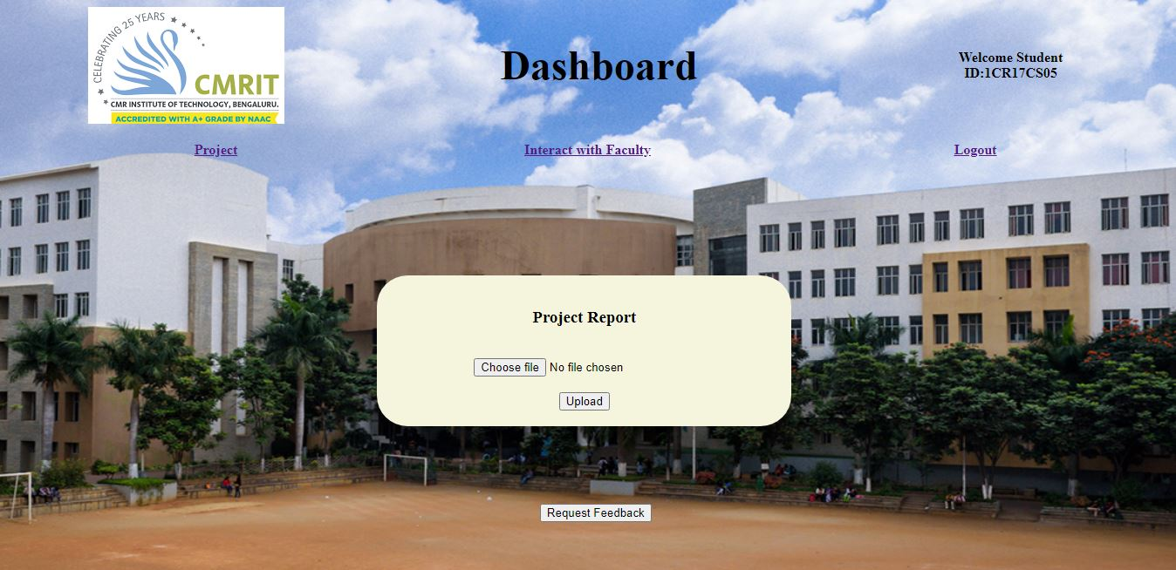
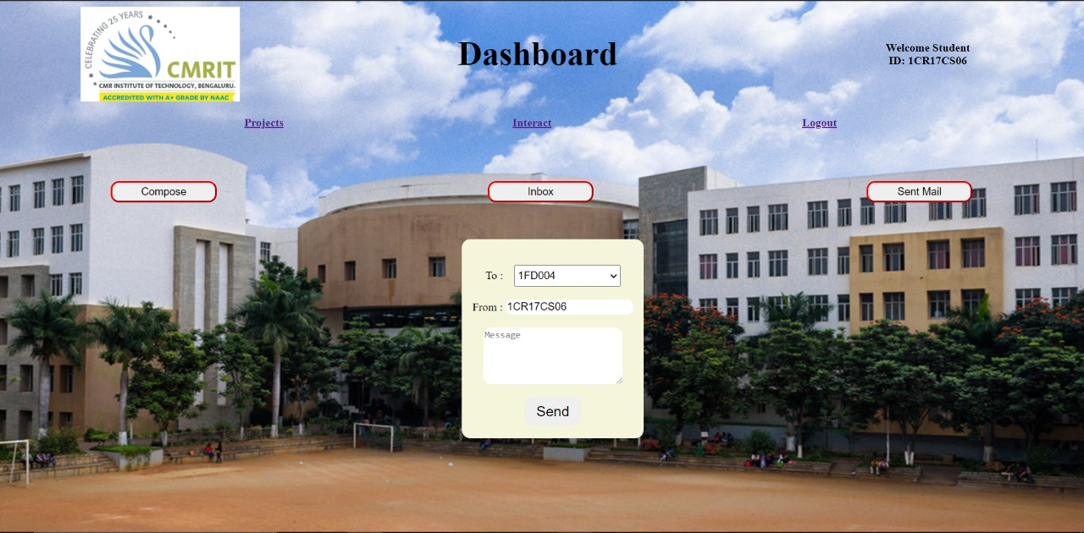
Student Dashboard:
Project Proposal
Interact with Faculty

Slide 12
A faculty once logged in can:
View Projects: Can provide feedback to the students, download project proposal, provide an assessment
Mail: Can compose the mail, check the inbox or sent mail.
Meeting: The faculty can arrange a meeting with a student and fix the date and time.
Logout: The faculty may logout

Slide 13
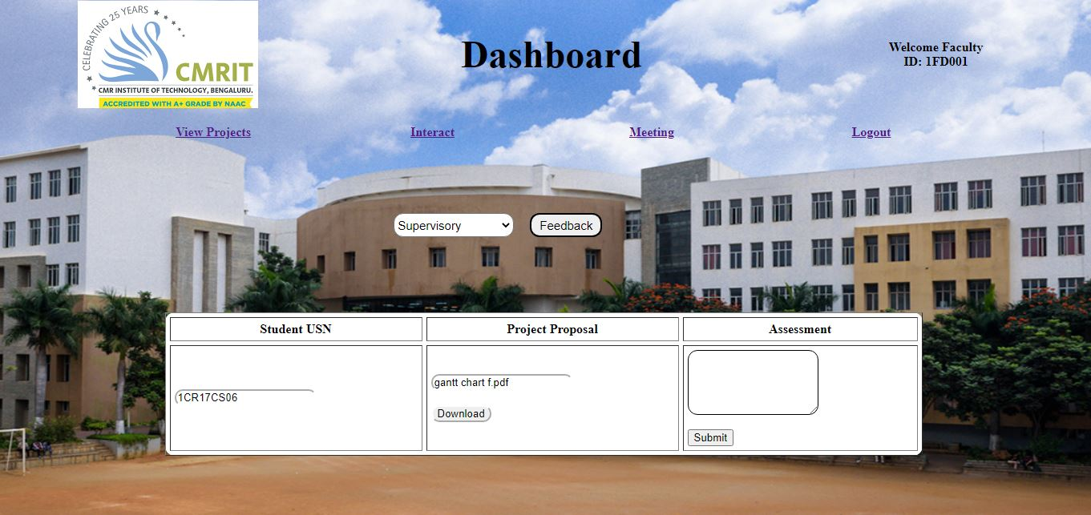
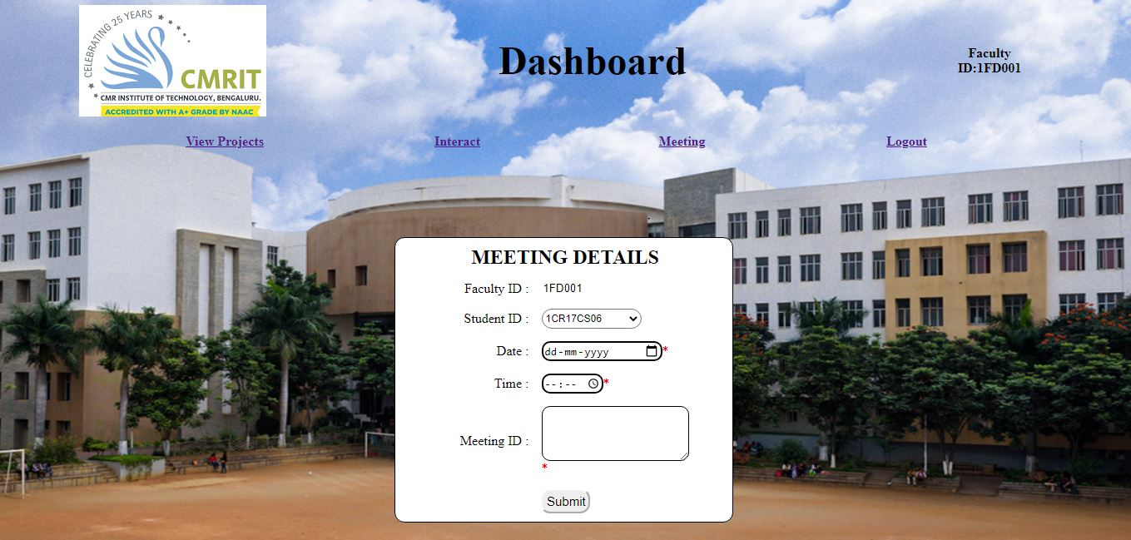
Faculty Dashboard:
View and Evaluate Project
Review meeting

Slide 14
Thank you!!

